Slide 1
Project Name :
NLP :
Natural Language Processing

Slide 2
Group Members :
Arindam Brahmachary
KARNATI VARUN REDDY
MUDAMALA PAVAN KUMAR
NIVEDITHA P S
POTTHULA SRIMAN
Rinu A R
Triveni Kishor Zoting

Slide 3
Introduction :
A technique is used in the natural language processing (NLP).
It is used to identify and classify the opinion expressed in the text as a positive, negative or neural.
NLTK (Natural Language Toolkit) is a leading platform for building Python programs to work with human language data. It provides easy-to-use interfaces to over 50 corpora and lexical resources, such as WordNet, along with a suite of text processing libraries for classification, tokenization, stemming, tagging, parsing, and more. NLTK is widely used for educational purposes as well as practical NLP tasks.

Slide 4
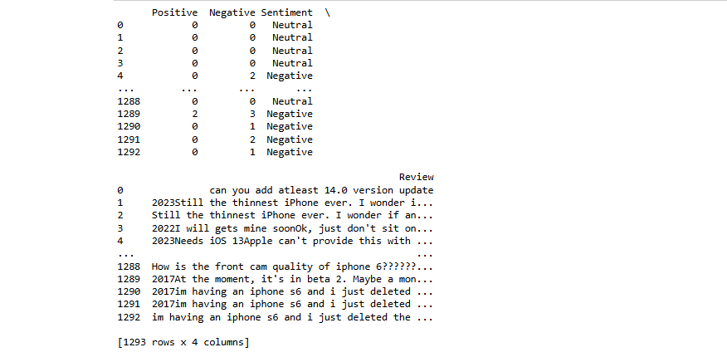
Sentimental Analysis :
Sentiment Analysis is the process of determining whether a piece of writing is positive, negative, or neutral. It is used in a variety of applications, including analyzing customer reviews, social media comments, and more. Common tools and techniques used in sentiment analysis include lexicon-based approaches and machine learning models.

Slide 5
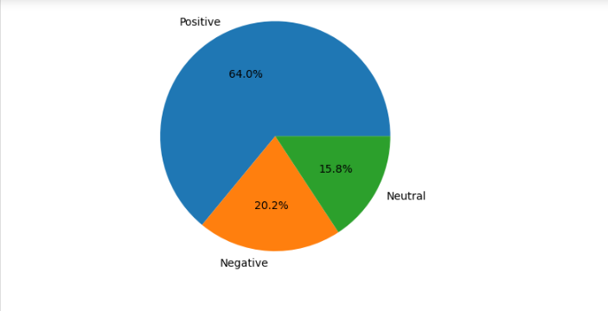
Sentimental Analysis Using nltk :
NLTK provides several tools for sentiment analysis, including the VADER (Valence Aware Dictionary and sentiment Reasoner) model. VADER is a lexicon and rule-based sentiment analysis tool that is specifically attuned to sentiments expressed in social media.

Slide 6
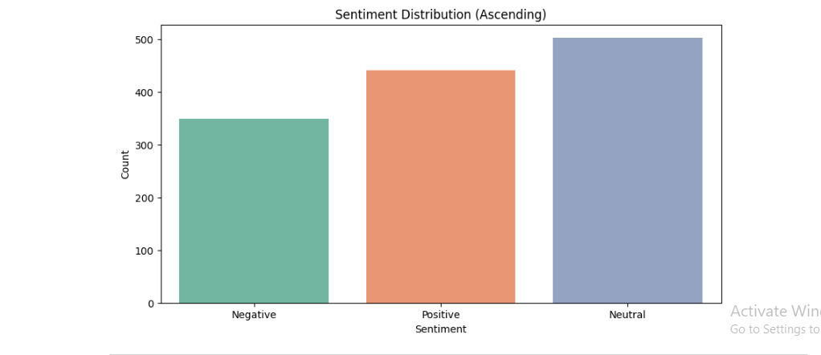
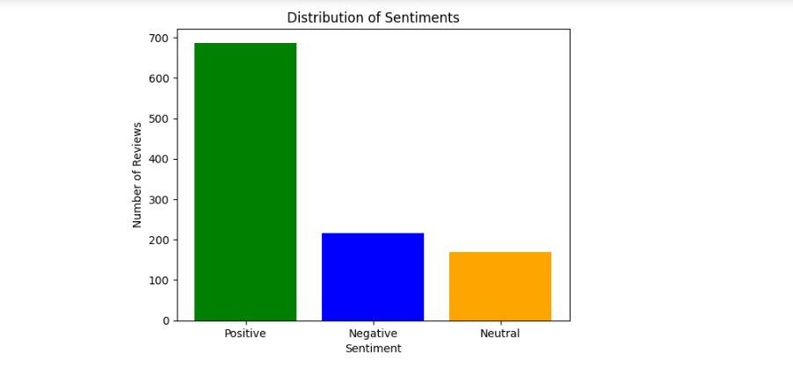
Exploratory Data Analysis (EDA) :
EDA is the process of analysing datasets to summarize their main characteristics, often using visual methods. Key steps in EDA include understanding data types, handling missing values, and visualizing data distributions. Common tools used in EDA are pandas for data manipulation and matplotlib/seaborn for data visualization.

Slide 7
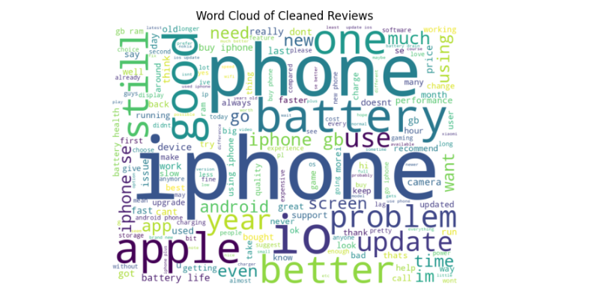
Feature Engineering for Model Building:
Feature engineering involves transforming raw data into features that better represent the underlying problem to predictive models. Common techniques include tokenization, removing stop words, and converting text to numerical features using TF-IDF or word embeddings.

Slide 8
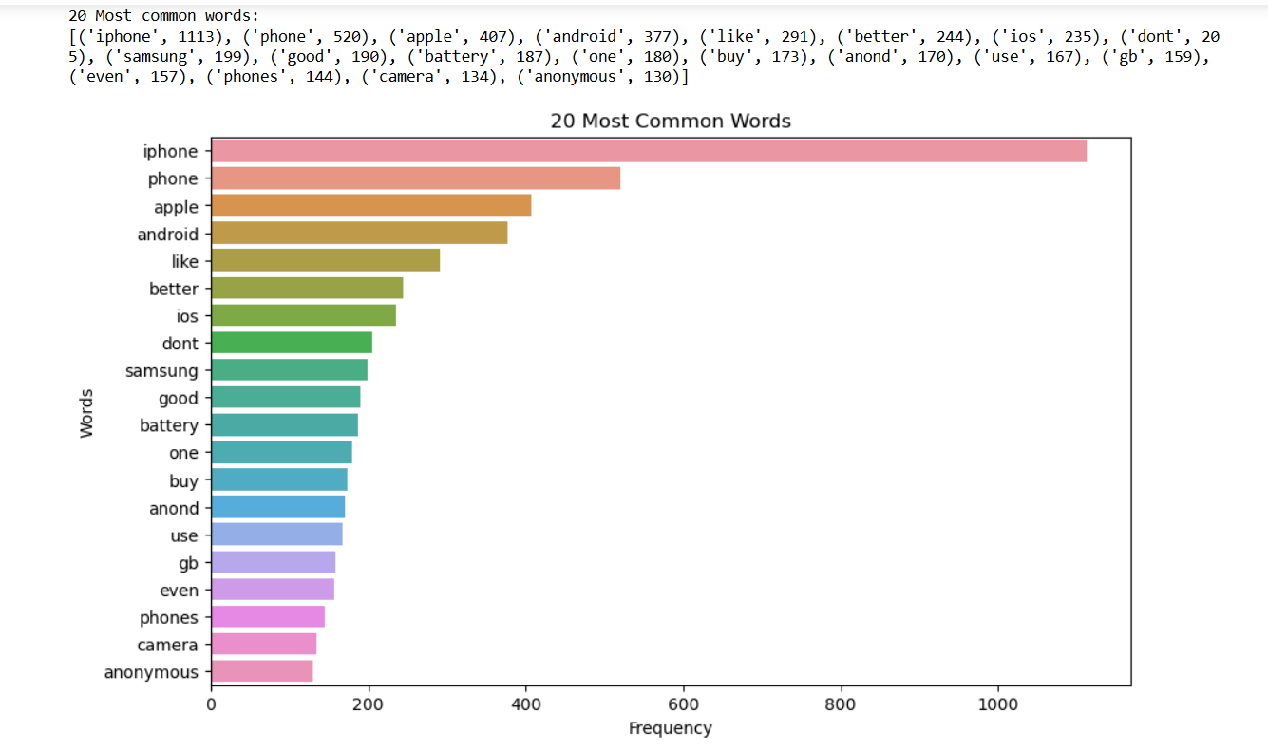

Slide 9
Training the sentiment analysis model :
Split the data into training and testing sets. Choose a machine learning model (e.g., Support Vector Machine, Naive Bayes).Train the model using the training data.
Accuracy : Logistic Regression : 0.78CNN: 0.86RNN: 0.78

Slide 10
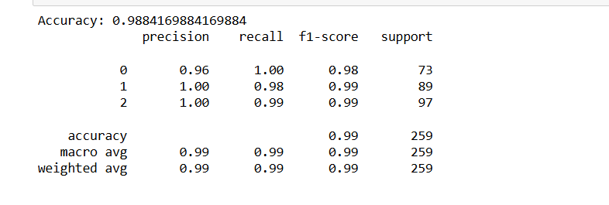
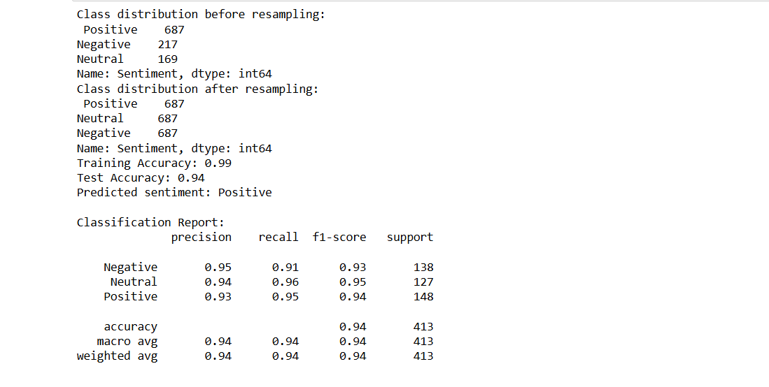
Model Evaluation :
Evaluate the model using metrics such as accuracy, precision, recall, and F1-score.Visualize the results using confusion matrices and ROC curves.

Slide 11
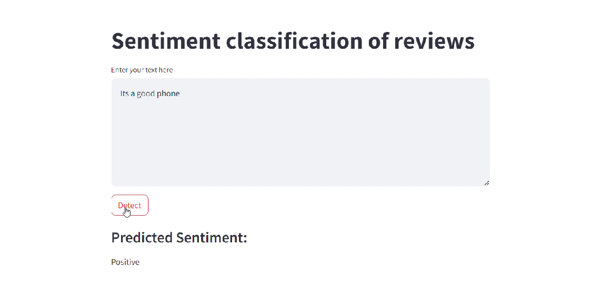
Model Deployment :
Deploying the model to a production environment using steamlit to create a RESTful API

Slide 12
Conclusion :
Summarize the key findings and the effectiveness of the sentiment analysis model. Discuss the potential business implications and future improvements. Highlight the importance of continuous monitoring and retraining of the model to maintain its performance.

Slide 13


